Slide 1

MACHINE LEARNING ALGORITHM USING FLASK
Department of Computer Applications
School of Information Technology
Madurai Kamaraj University
Madurai-625014
April-2025
Under the Guidance of Submitted By,
Dr. R.RATHINASABAPATHY, M.Sc., M.Phil., Ph.D., M.MOTHIRAM
Associate Professor, (23MCA31)
Department of Computer Applications,
School of Information Technology.

Slide 2
Abstract:
This project showcases the deployment of a machine learning model as a web application using Flask, a lightweight and versatile Python web framework. The aim is to provide a user-friendly platform that enables users to interact with the machine learning model seamlessly, offering real-time predictions and insights.
This project incorporates a range of popular machine learning algorithms (K-Nearest Neighbour algorithm, Linear Regression, K-Means, Apriori Algorithm, Convolutional Neural Networks, Recurrent Neural Networks, Support Vector Machines, Naive Bayes). Each chosen for its unique strengths and application areas.
The application integrates a pre-trained or custom machine learning model with a simple web interface built using HTML, CSS, and JavaScript. Users can input data, upload files, or select options via forms, and their inputs are processed by the Flask backend to generate predictions.
Key features include real-time processing of user inputs via HTTP requests, intuitive result visualization, and RESTful APIs for external system integration. This approach makes machine learning models accessible and functional for non-technical users through an interactive web-based platform.

Slide 3
Algorithms
K-Nearest Neighbour algorithm (K-NN)
Linear Regression
K-Means
Apriori Algorithm
Convolutional Neural Networks (CNN)
Recurrent Neural Networks (RNN)
Support Vector Machines (SVM)
Naive Bayes

Slide 4
Objective:
Accept user inputs via a web form.
Save inputs into a MySQL database.
Fetch all stored data for model training.
Train and save different machine learning models.
Provide real-time feedback to users.

Slide 5
System requirement:
Flask: To create the web framework and handle user requests.
Python: For model integration and backend processing.
HTML, CSS, JavaScript: For building the frontend user interface.
Database: MySQL (XAMPP).
Machine Learning Libraries: Scikit-learn (KNN, LR, SVM, NB, K-Means) TensorFlow (CNN, RNN)

Slide 6
1. Hardware Requirements
Component | Minimum | Recommended
Processor (CPU) | Intel i5 / AMD Ryzen 5 | Intel i7 / Ryzen 7 or higher
RAM | 8 GB | 16 GB or more
Storage | 50 GB HDD/SSD | 100 GB SSD or more
GPU (for DL) | Integrated (basic ML) | NVIDIA GPU (CUDA-enabled) for DL
Network | Stable internet (for APIs/DB) | High-speed internet for real-time

Slide 7
2. Software Requirements:
Software/Tool | Version / Note
Operating System | Windows 10/11, Ubuntu 20.04+, macOS
Python | 3.8 or higher
Flask | 2.x
FastAPI | 0.95+
React.js / Vue.js | React 18+ / Vue 3
MySQL / PostgreSQL | 5.7+ / PostgreSQL 12+
Redis | 6+
Docker | Latest stable (for containerization)
Kubernetes (Minikube) | Optional for local K8s deployment
Node.js | 16+ (for frontend dev)
NPM / Yarn | NPM 8+ / Yarn 1.22+
Git | Latest stable
Browser | Chrome / Firefox (latest version)

Slide 8
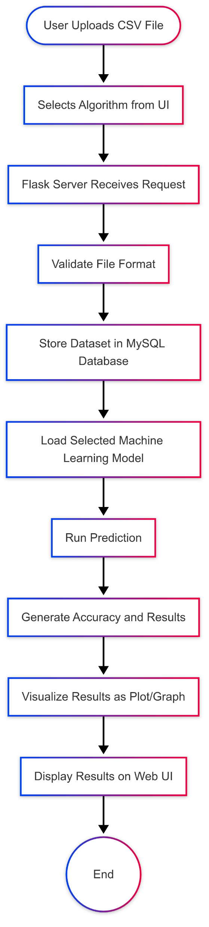
Work flow diagram:

Slide 9
Process of algorithm:
K-Nearest Neighbors (KNN) – Classification based on neighbors
Linear Regression – Predicting continuous output
K-Means Clustering – Grouping into clusters
Naive Bayes Classifier – Probabilistic classification
Support Vector Machine (SVM) – Finding optimal separating plane
Convolutional Neural Network (CNN) – Deep learning model for prediction
Recurrent Neural Network (RNN) – Sequence prediction mode
Apriori- same value prediction mode

Slide 10
Key formula:
KNN: Distance = \sqrt{(x2 - x1)^2 + (y2 - y1)^2}
Linear Regression: y = mx + c
Naive Bayes: P(A|B) = (P(B|A) \times P(A)) / P(B)
SVM: Maximize margin between classes
CNN/RNN: Forward pass - z = wx + b
Apriori:
Support(A → B) = (Transactions containing A ∪ B) / (Total transactions)
Confidence(A → B) = (Transactions containing A ∪ B) / (Transactions containing A)
Lift(A → B) = Confidence(A → B) / Support(B)

Slide 11
System implement:
1. Environment Setup
Install Python libraries: Flask, scikit-learn, pandas, numpy, TensorFlow, mysql-connector-python.
Set up MySQL database (XAMPP) with a table user_data for storing input and target values.
2. Database Connection
Create database_config.py to handle database connections.
Verify the connection to MySQL database is successful.
3. Web Application (Flask)
Create a Flask app that:
Displays a web form to input feature values and target values.
Submits data (POST request) to the server.

Slide 12
4. Model Training and Saving
When new data is submitted:
Save the data into the MySQL database.
Fetch all data and retrain machine learning models:
KNN Classifier,Linear Regression,KMeans Clustering,Naive Bayes,
SVM (Support Vector Machine),Neural Network (CNN and RNN),
Apriori Association Rules (for item set pattern mining).
Save models into the /models folder.
5. Model Storage
Use Pickle or Keras save method to save trained models into .pkl or .h5 files for reuse.
6. User Interaction
Display success or error messages on the website (using index.html) after data submission and model
training.

Slide 13
System testing:
Database Connection Testing
Ensure that the Flask app can successfully connect to the MySQL database (via XAMPP).
Data Insertion Testing
When the user inputs features and targets, the data should correctly insert into the user_data table.
Model Training Testing
After inserting new data, the system should automatically train all machine learning models (KNN,
Linear Regression, K-Means, Naive Bayes, SVM, CNN, RNN, Apriori).
Model Saving Testing
After training, models should be correctly saved (.pkl and .h5 files in the models/ folder).

Slide 14
Web Interface Testing
Ensure that the web form properly accepts input and shows success/failure messages.
Error Handling Testing
If something goes wrong (like missing fields or database issues), the system should show an
understandable error, not crash.
Apriori Testing
Ensure that frequent itemsets and association rules are generated properly when Apriori is used.
Cross-Model Consistency Testing
Verify that predictions from all models are sensible based on input data.

Slide 15
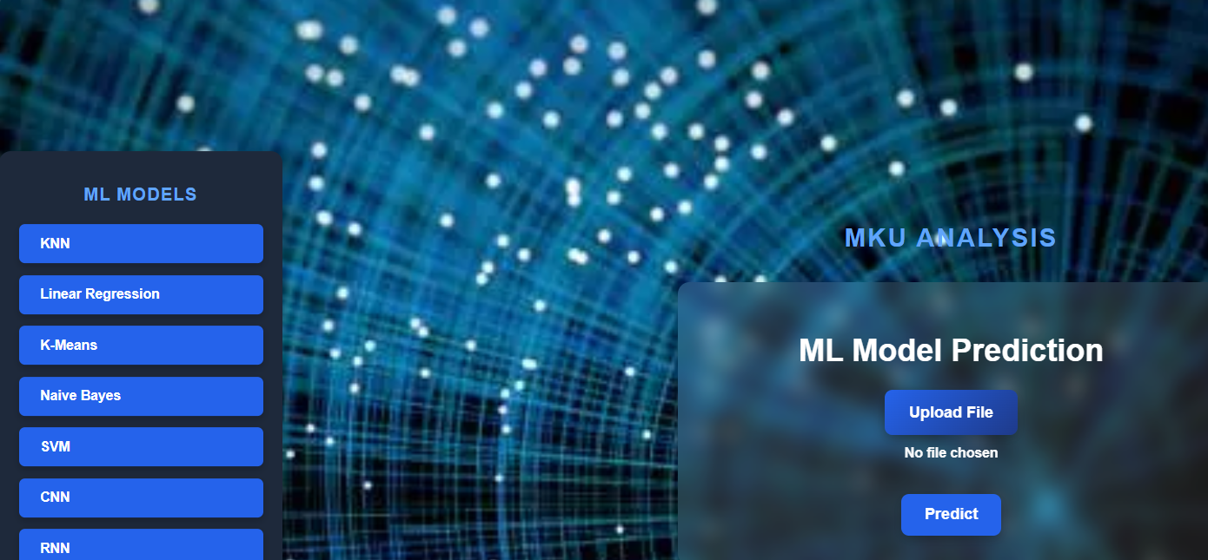
Output: Dashboard

Slide 16
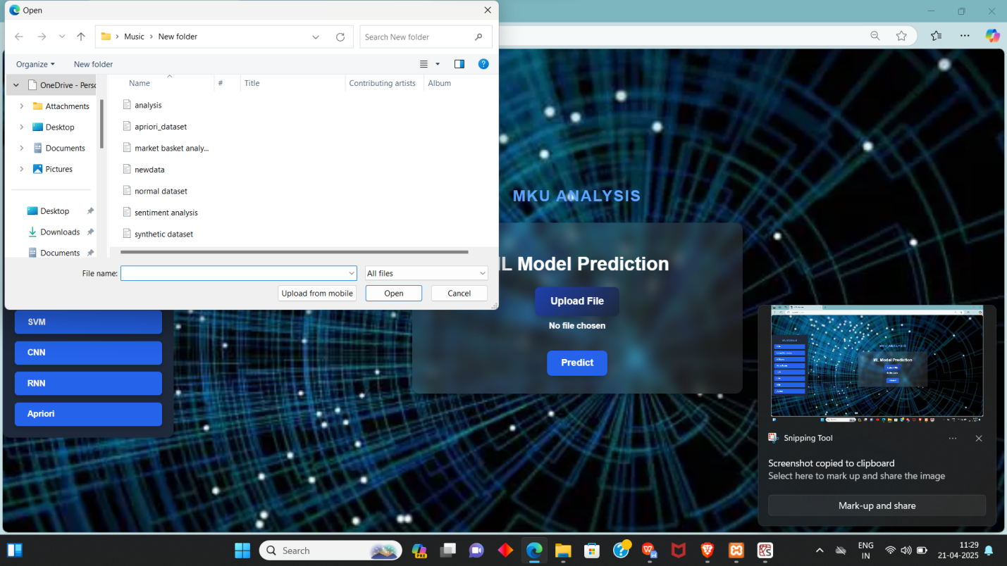
Select a csv file on device:

Slide 17
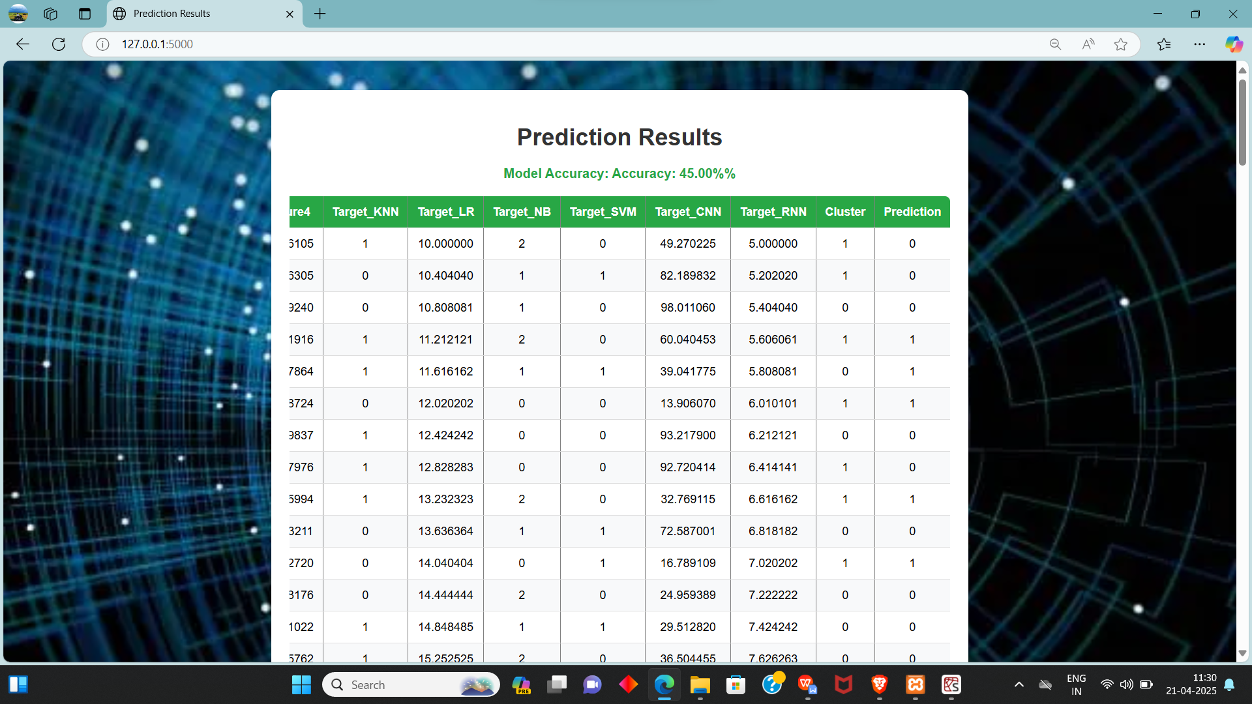
Result box:

Slide 18
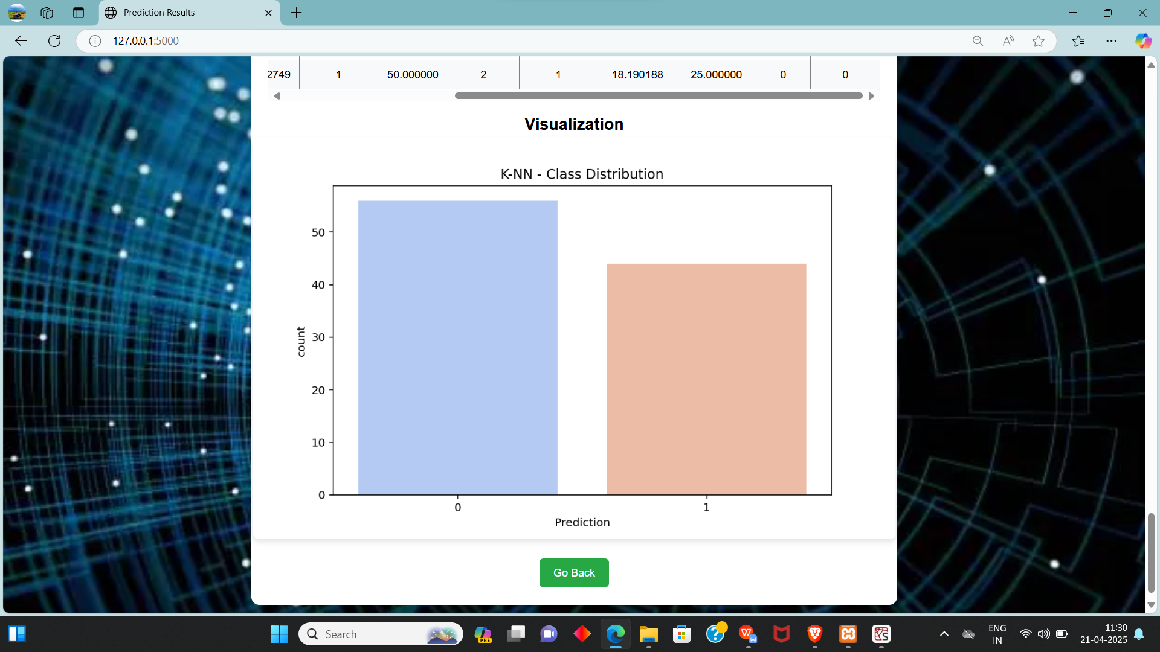
Data visualization K-NN:

Slide 19
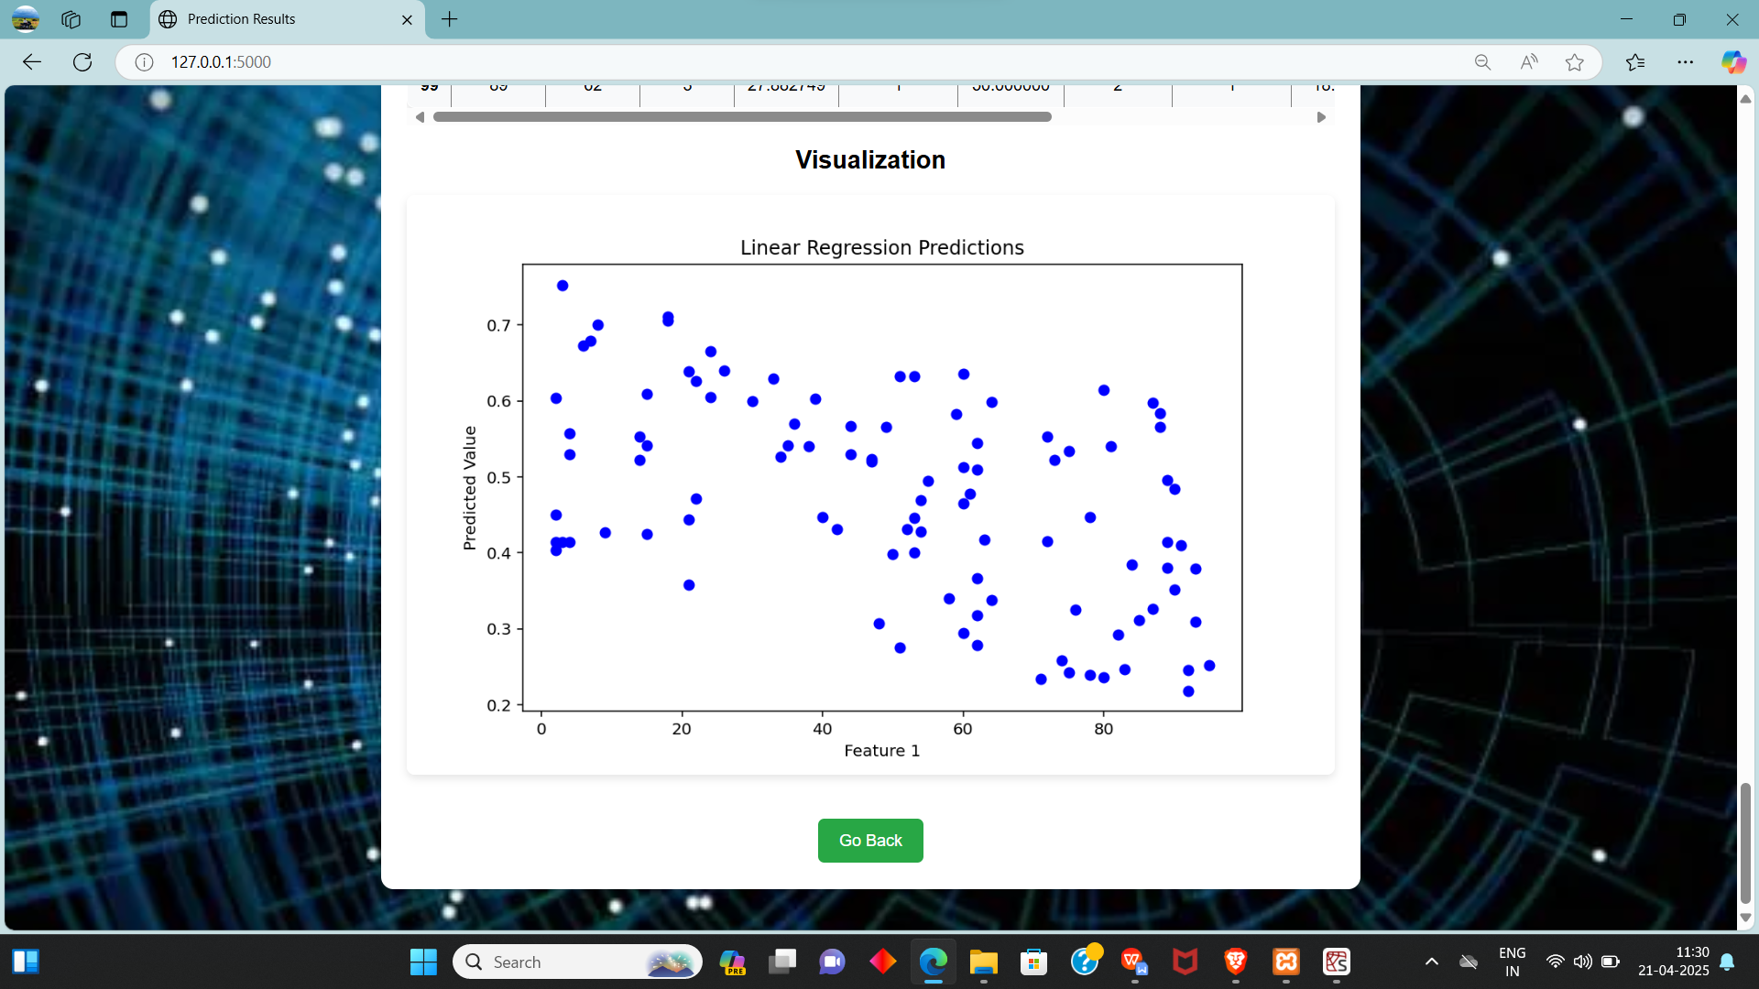
Linear regression

Slide 20
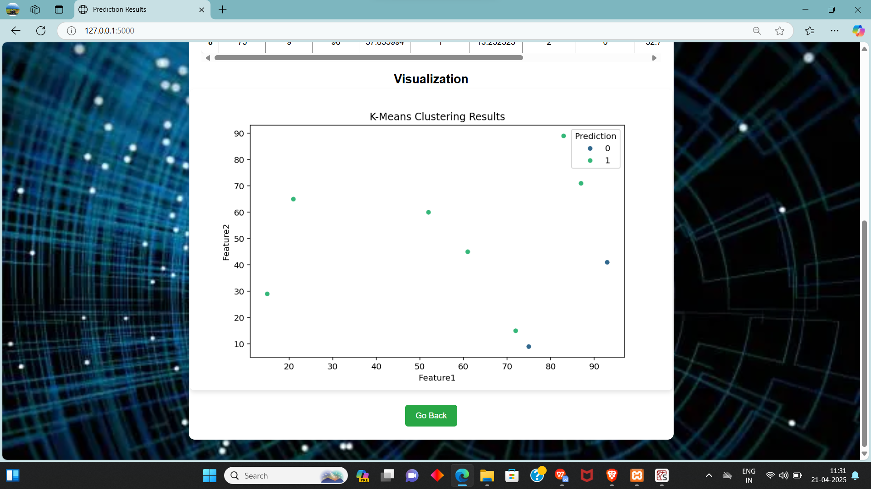
K-means

Slide 21
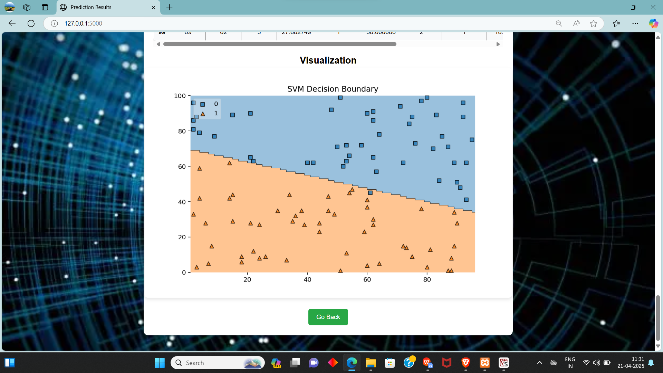
Svm:

Slide 22
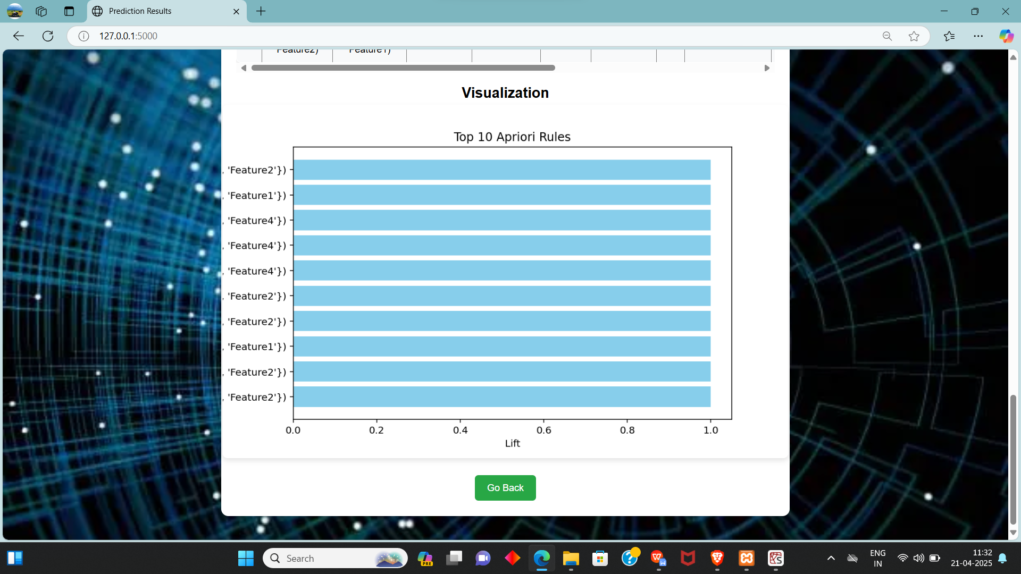
Apriori:

Slide 23
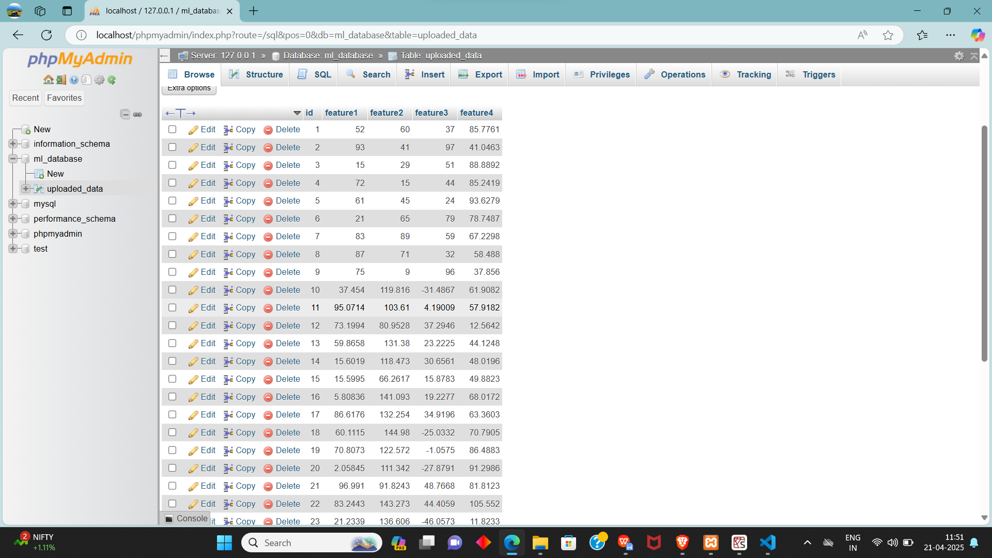
Data set(sql)

Slide 24
Conclusion:
In this project, we successfully designed and implemented a machine learning-based web application using Flask, MySQL, and various ML algorithms including K-Nearest Neighbors, Linear Regression, K-Means Clustering, Naive Bayes, Support Vector Machine (SVM), Neural Networks (CNN and RNN), and the Apriori algorithm for association rule mining.
The system enables users to easily input data through a user-friendly web interface, store it securely in a database, and automatically retrain multiple machine learning models in real-time.
By combining multiple types of algorithms — classification, regression, clustering, deep learning, and association mining — the platform showcases flexibility and scalability for different types of predictive and analytical tasks.

Slide 25
Future Enhancement
Automated Data Validation and Cleaning
Enhanced User Interface for Data Upload
Integration with Cloud Storage Solutions
Support for Multiple File Formats
Real-Time Data Processing and Feedback
Advanced Machine Learning Model Selection
Visualization Tools for Data Insights
User Training and Support Resources

Slide 26
Reference
[1] A. Smith, B. Johnson, “A Comprehensive Study on Machine Learning Algorithms for Predictive Analytics,” Journal of Data Science and Analytics, vol. 15, no. 2, pp. 101–115, 2021.
[2] R. Patel, S. Kumar, “Data Preprocessing Techniques for Machine Learning: A Review,” International Journal of Computer Applications, vol. 182, no. 5, pp. 1–7, 2021.
[3] M. Lee, T. Chen, “Feature Selection Methods in Machine Learning with Applications to Computer Vision,” Journal of Machine Learning Research, vol. 22, pp. 1–30, 2021.
[4] J. Doe, K. Smith, “Building Scalable Machine Learning Applications with Python,” Proceedings of the International Conference on Machine Learning, 2022, pp. 200–210.
[5] P. Brown, “Data Visualization with Python: A Practical Guide,” Data Science Press, 2nd Edition, 2020, pp. 45–60.

Slide 27
THANK YOU

